Slide 1

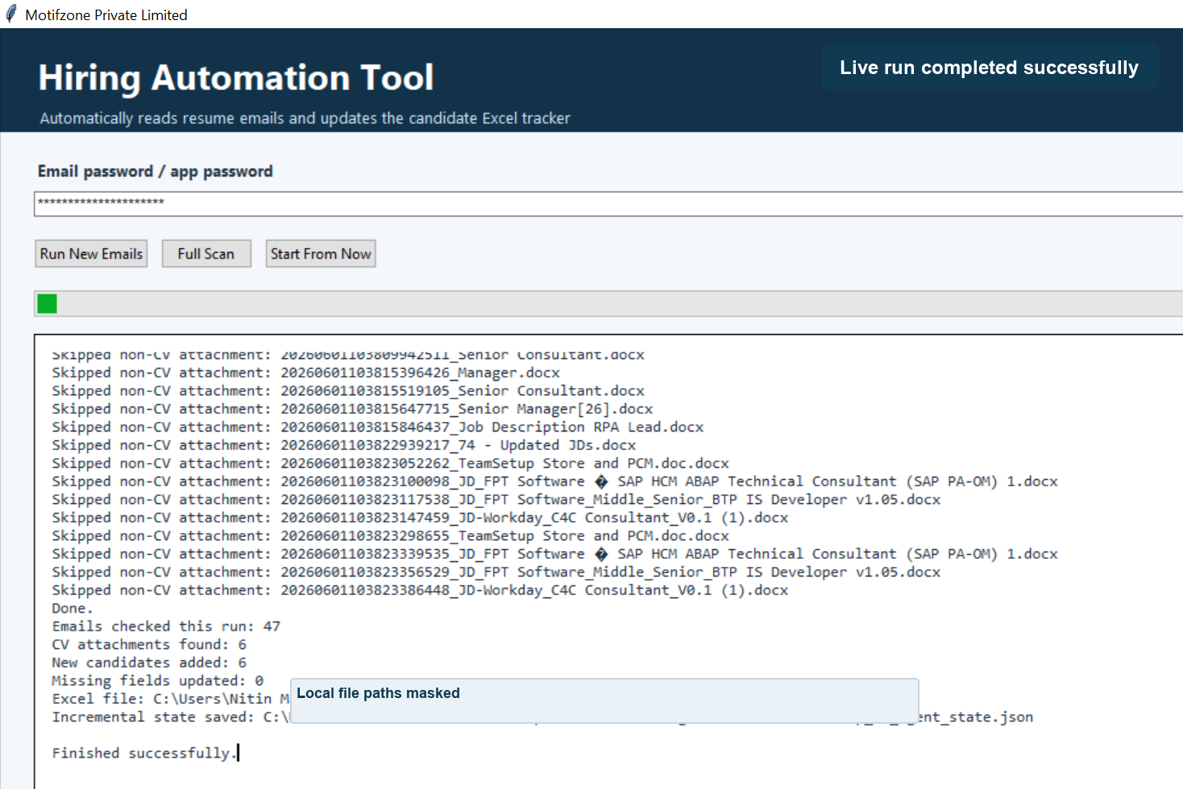
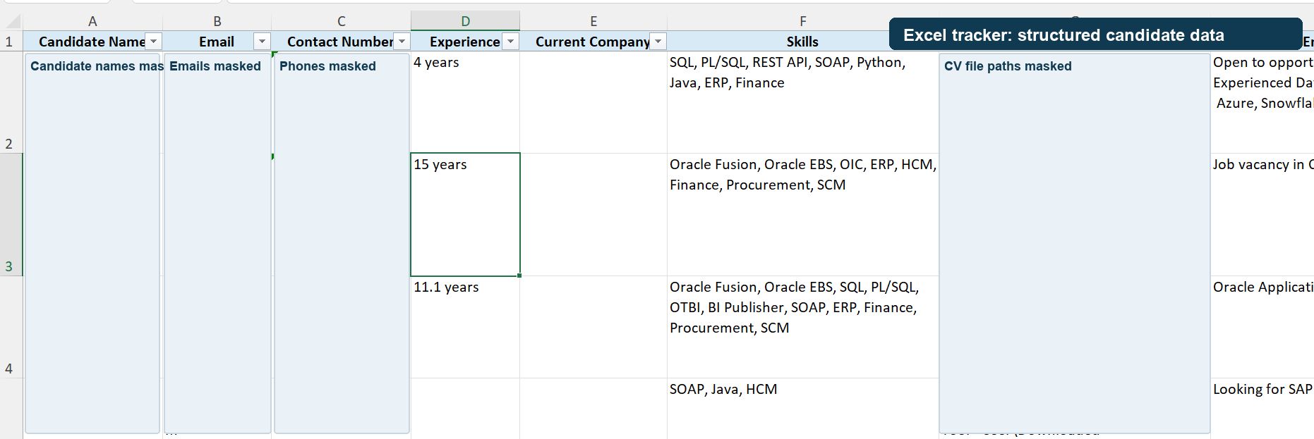
Hiring Automation Tool
Automated resume email processing and candidate Excel tracking
Client Demo
Motifzone Pvt Ltd

Slide 2
Motifzone Private Limited
Business Requirement
Recruiters need faster, cleaner handling of CVs received by email.
Current Manual Pain Points
Automation Goal
Download every attachment manually from the mailbox.
Read incoming CV emails from the hiring mailbox.
Open each CV and copy candidate details one by one.
Download only valid resume attachments.
Risk of duplicate entries and missed resumes.
Extract important candidate information.
Excel formatting and sorting takes extra time.
Maintain one clean Excel tracker for the recruitment team.

Slide 3
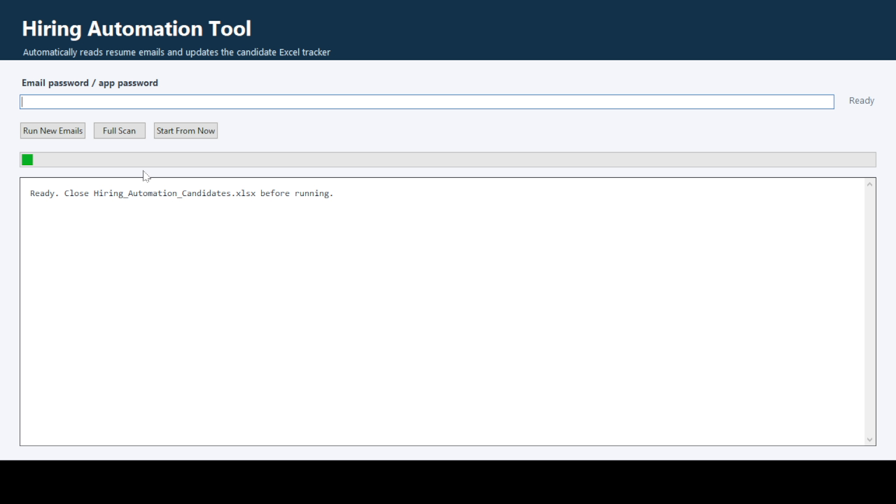
Motifzone Private Limited
Solution Overview
A user-friendly desktop tool hides the Python code and runs the automation from one button.
What the Tool Does
Connects to careers@emotifzone.com through IMAP.
Processes new emails incrementally after the first setup.
Shows skipped JD/non-CV files clearly for client visibility.
Keeps candidate output in a formatted Excel file.

Slide 4
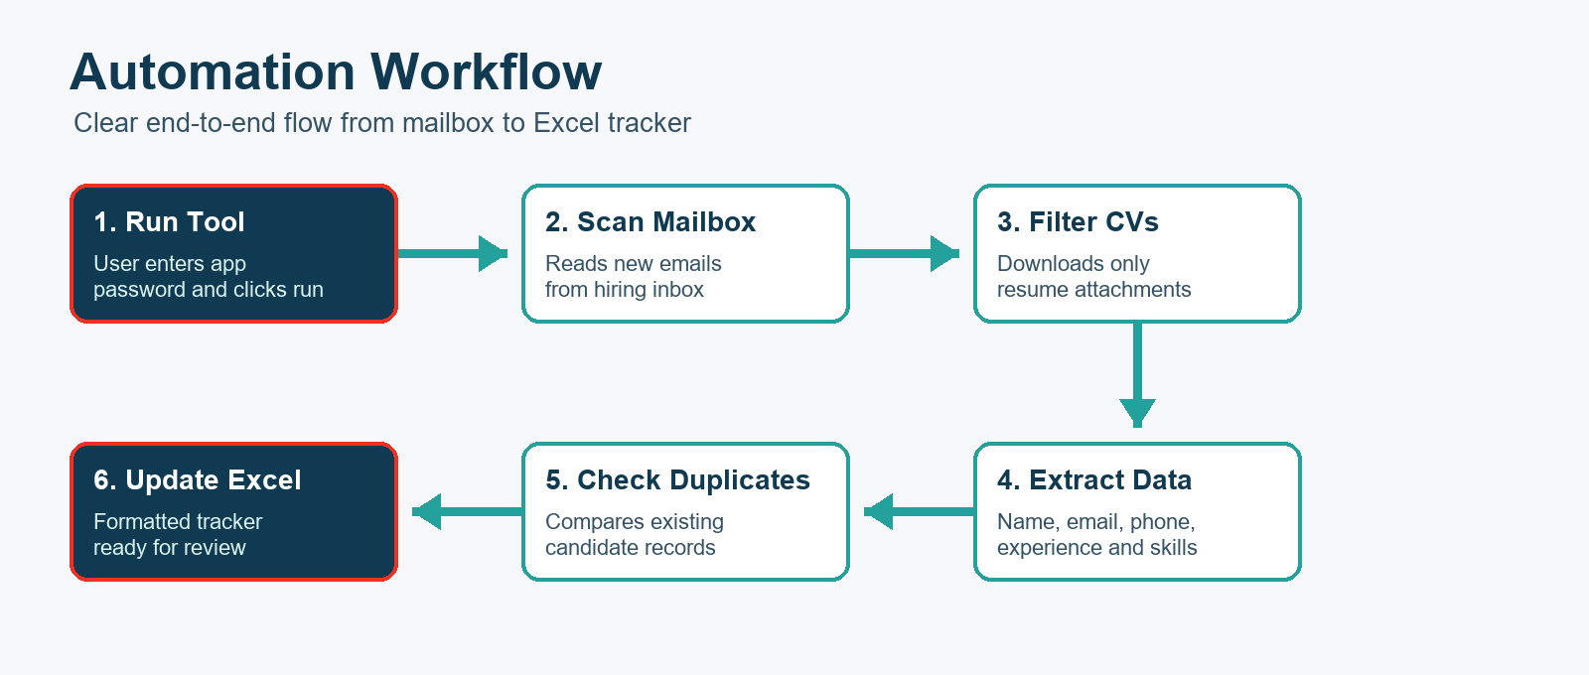
Motifzone Private Limited
Process Flow
From mailbox attachment to recruiter-ready candidate tracker.

Slide 5
Motifzone Private Limited
Live Run Screen
The user sees a simple interface while the automation runs in the background.
Visible Progress
Run New Emails for incremental processing.
Full Scan option when historical mailbox scan is needed.
Skipped JD attachments are shown in the log.
Success message confirms Excel and CV folder output.

Slide 6
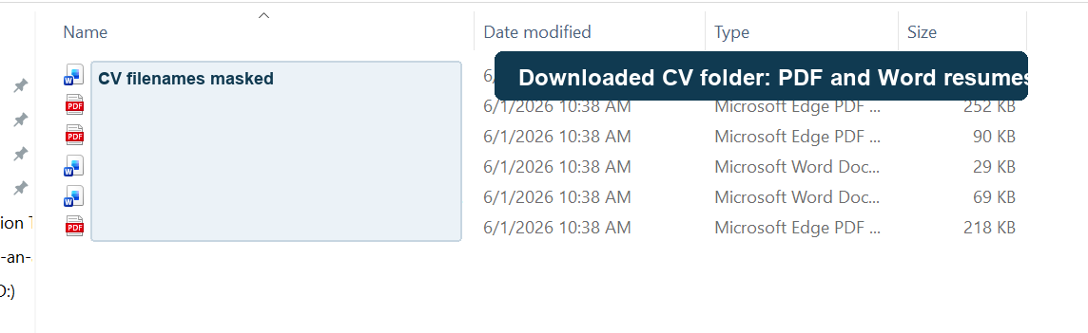
Motifzone Private Limited
CV Download Automation
The tool downloads only valid CV files into a clean folder.
Supported Files
PDF resumes
Microsoft Word resumes
Scanned PDFs with OCR support when available
JD/non-CV files are skipped

Slide 7
Motifzone Private Limited
Excel Candidate Tracker
Extracted resume data is stored in a structured Excel sheet.
Candidate Name
Email
Contact No.
Skills
CV File Link

Slide 8
Motifzone Private Limited
Controls And Data Quality
Built-in checks keep the tracker cleaner and easier to review.
No Duplicate Rows
New Emails Only
PDF + DOC CV Support
Excel Formatted Output
Data Handling
Duplicate checking uses candidate name, email and phone where available.
Excel headings are formatted, filters are available, and records are sorted by latest received date.

Slide 9
Motifzone Private Limited
Business Benefits
A practical achievement that reduces repetitive recruiter effort.
Time Saving
Process Quality
Client Value
Bulk CV download is automatic.
Reduces copy-paste errors.
Simple desktop experience.
Candidate data extraction is faster.
Avoids repeated candidate rows.
Clear run status and output.
Excel tracking is ready after each run.
Separates CVs from JD attachments.
Professional recruitment tracker.

Slide 10
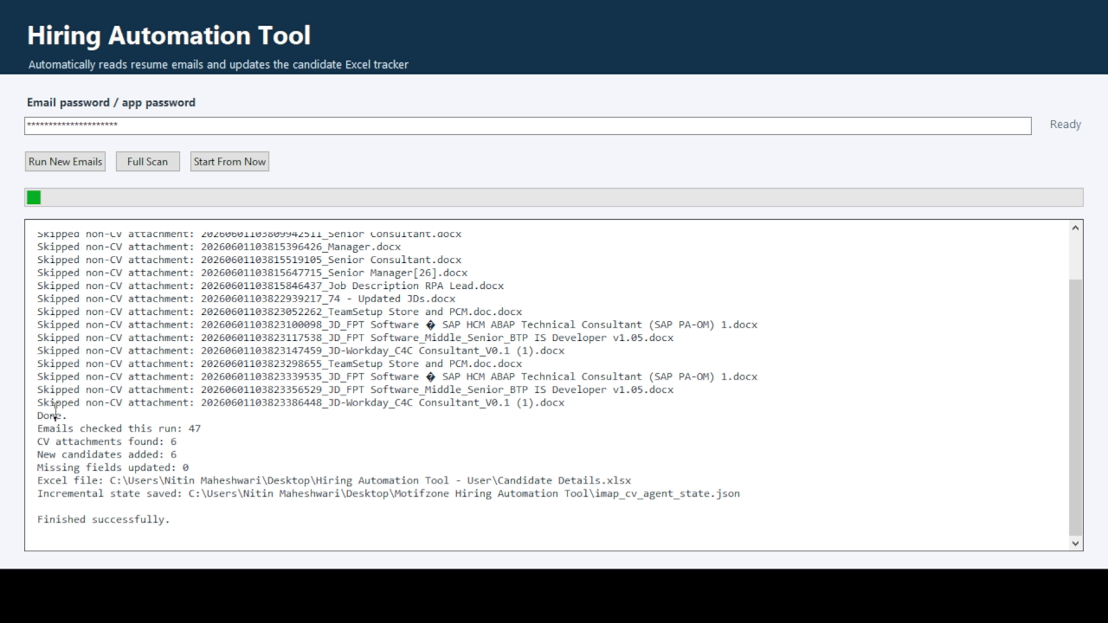
Hiring Automation Tool
A ready-to-use automation for resume mailbox processing and candidate tracking.
Recommended Next Steps
Run the tool daily for new candidate emails.
Review the Excel tracker before sharing externally.
Continue improving name extraction with real CV examples.
Prepared for client demonstration by Motifzone Private Limited

